Slide 1

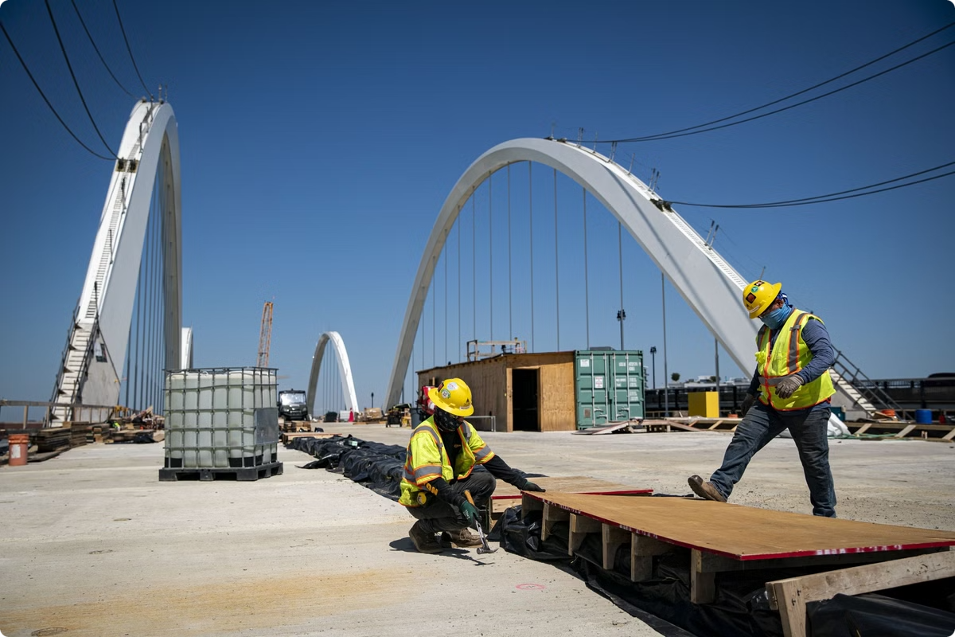

Analyzing Equity and Political Bias in IIJA Funding Allocation
This study examines the Infrastructure Investment and Jobs Act (IIJA) allocations by state. We investigate funding equity based on population and potential political bias favoring Biden-supporting states.
by Waheeb Algabri

Slide 2


Study Objectives
1
Equity Analysis
Investigate IIJA funding allocation equity based on state population demographics.
2
Political Bias Exploration
Examine potential bias favoring states that supported President Biden in 2020.
3
Contextual Factors
Consider additional factors like state GDP, infrastructure spending, and debt levels.

Slide 3






Data Sources
IIJA Funding Data
Provided by Prof. Peter, covering allocations up to March 2023.
Population Data
U.S. Census 2020-2023 estimates for accurate per capita calculations.
Election Results
State-level data on Biden vs Trump support in 2020 election.
Economic Indicators
State GDP, infrastructure spending, and debt data for context.

Slide 4


Methodology
1
Data Cleaning
Standardized and merged datasets from multiple sources for consistent analysis.
2
Metric Calculation
Computed spending per capita and classified states by 2020 election results.
3
Contextual Analysis
Incorporated debt per capita, GDP, and infrastructure metrics for comprehensive view.

Slide 5
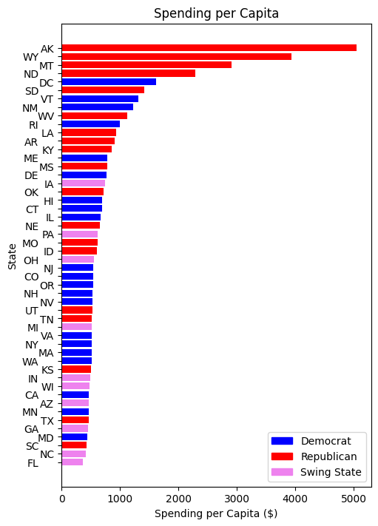
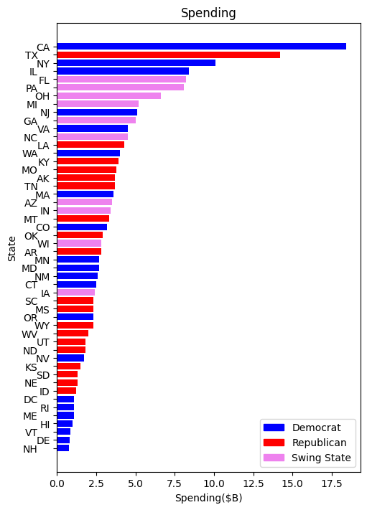
Spending
Caption
Caption

Slide 6
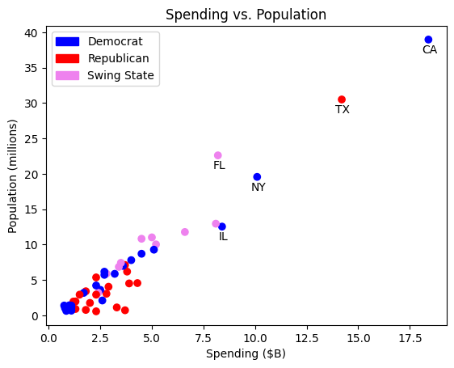
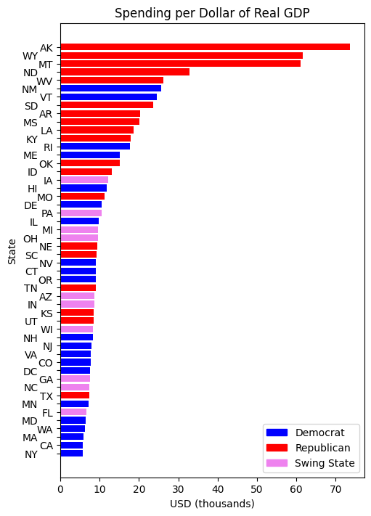
Spending and GDP
Caption
Caption

Slide 7
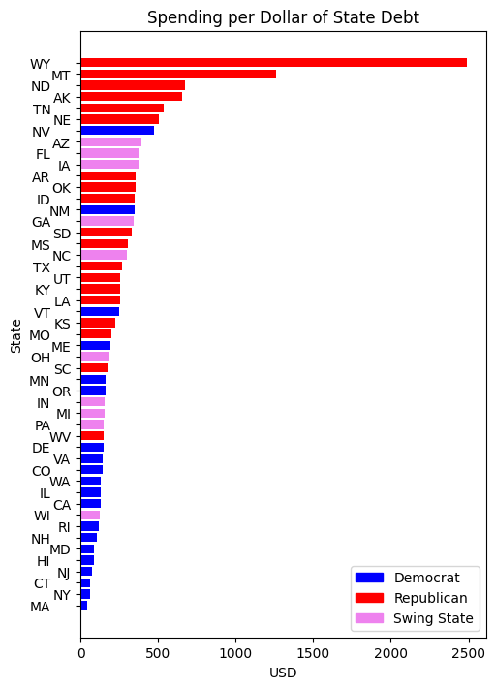
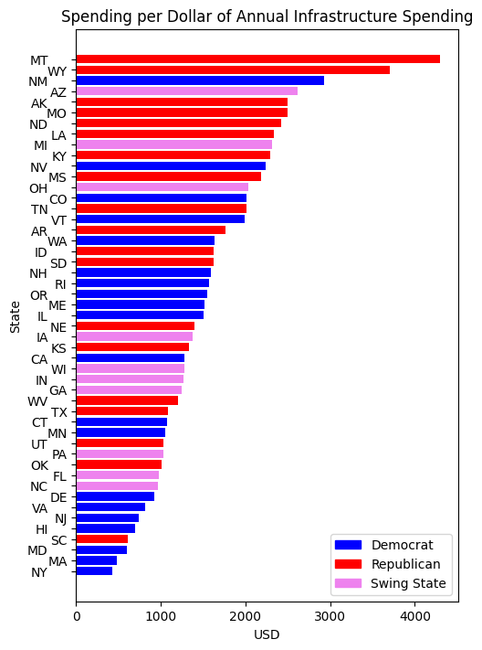
Caption
Caption

Slide 8
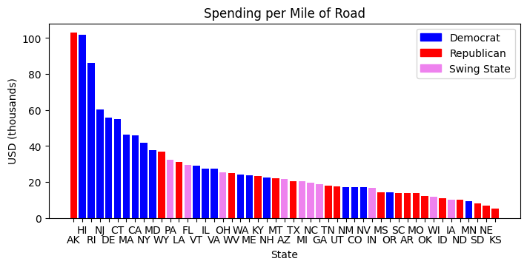
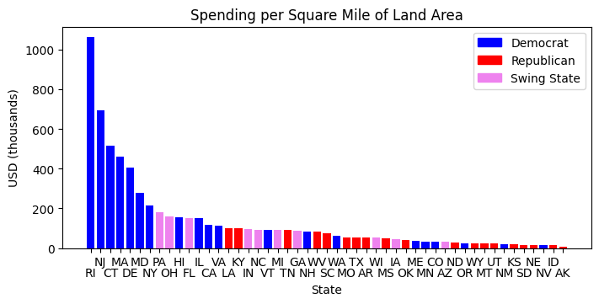
Caption
Caption

Slide 9
Equity Analysis Findings
Large States
Small States
Implications
California and other populous states received significant total funding. Per capita allocation varied widely among these states.
Some smaller states received disproportionately higher funding per capita. This raises questions about allocation equity.
The disparity in per capita funding suggests potential issues in the equitable distribution of IIJA resources.

Slide 10

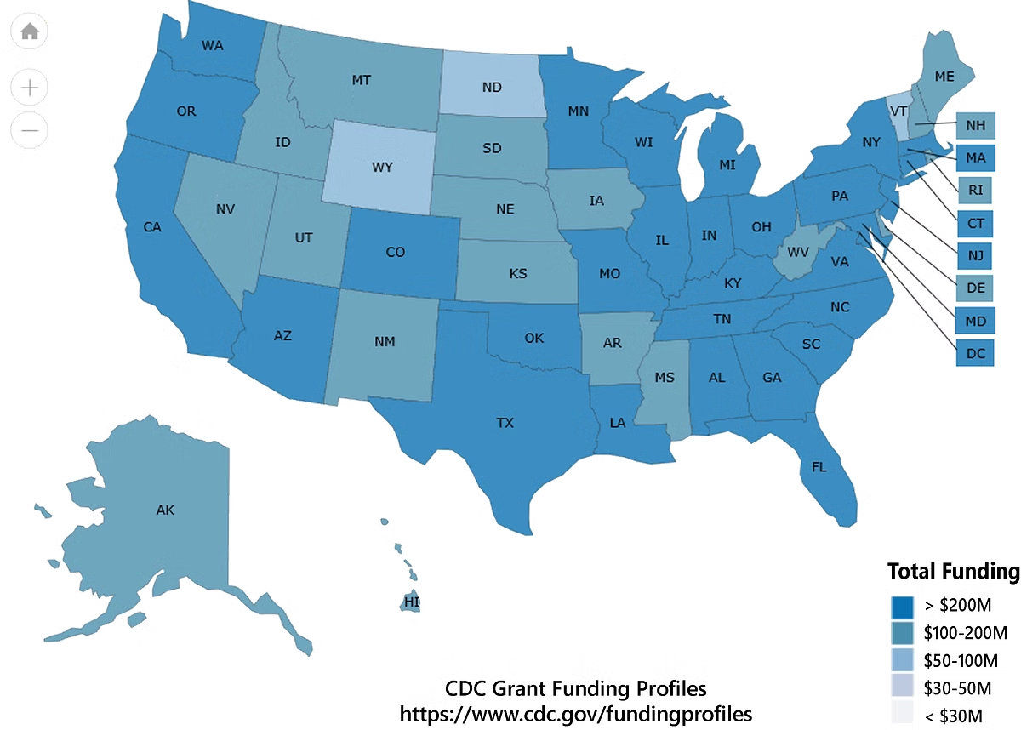
Political Bias Analysis Findings
Category
Average Funding Per Capita
Correlation with Swing State Status
Biden-supporting States
Slightly Higher
No Strong Correlation
Trump-supporting States
Slightly Lower
No Strong Correlation

